Slide 1

ER to Relational Mapping
Dr. Ejaz Ahmed

Slide 2
Objectives
Introduction
Usage of Datasets for Schema Implementation
Mapping Entity Types
Mapping Relationship Types
Mapping Multi-valued Attributes
Dr. Ejaz Ahmed

Slide 3
- Introduction
In the previous lectures we looked at conceptual database design using the ER diagram.
Here we are going to discuss in detail the process of mapping, or converting and ER design into a relational model. This is the logical design, or data model mapping, step as shown in the database design procedure.
We will start by describing how we map an ER diagram into a relational schema.
Dr. Ejaz Ahmed

Slide 4
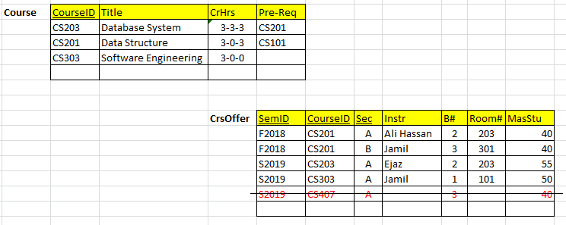
Datasets – Schema Implementation
Applying Knowledge – Do able artifacts (Implementation)
Each mapped table will have fewer records
Records should be references with possible variations in tables
Try to avoid any data redundancy or duplication?
Dr. Ejaz Ahmed
Notes:
Applying means how exactly you will apply concept of PK, Surr. Key, Comp Key and FK with additional constraints
Almost all possible variety of records in a data. Such variety should be applicable for the user. Fewer numbers of records are sufficient for the purpose of initial software development/ programming. Later on records can be increased for formal Testing

Slide 5
- Mapping Entity Types
Mapping of Regular Entity Types +
Mapping of Weak Entity Types +
Dr. Ejaz Ahmed

Slide 6
-- Mapping of Regular Entity Types …
For each regular (strong) entity type E in the ER schema:
  Create a relation R that includes all the simple attributes of E.
  Include only the simple components of any composite attribute.
  Choose one of the key attributes of E as primary key for R.
  If the chosen key of E is composite, then the set of simple attributes that form it will together form the primary key of R.
Dr. Ejaz Ahmed

Slide 7
… -- Mapping of Regular Entity Types
In the company database example, we create the relations EMPLOYEE, DEPARTMENT, and PROJECT to correspond to the regular entity types EMPLOYEE, DEPARTMENT, and PROJECT .
The foreign key and relationship attributes, if any, are not included yet, they will be added during the subsequent steps. This includes the attributes of SUPERSSN and DNO of EMPLOYEE; MGRSSN and MGRSTARTDATE of DEPARTMENT; and DNUM of PROJECT.
We choose SSN, DNUMBER and PNUMBER, as primary key for relations EMPLOYEE, DEPARTMENT, and PROJECT respectively
Dr. Ejaz Ahmed

Slide 8
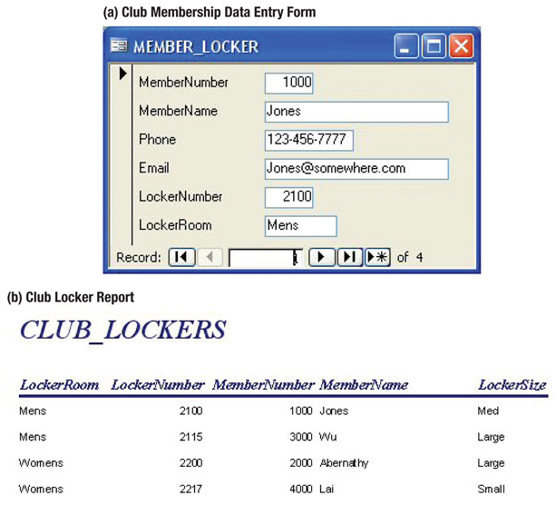
Strong Entity Patterns:
1:1 Strong Entity Relationships
Dr. Ejaz Ahmed

Slide 9
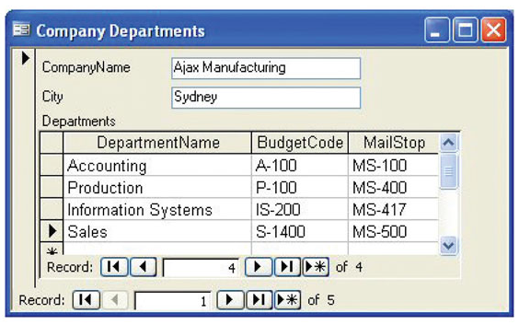
Strong Entity Patterns:
1:N Strong Entity Relationships
See Lab Form/ Report Development document
Dr. Ejaz Ahmed

Slide 10
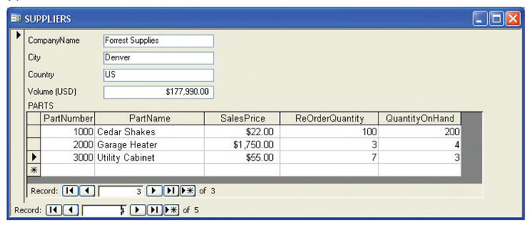
Strong Entity Patterns:
N:M Strong Entity Relationships
Dr. Ejaz Ahmed
Notes:
M-N relationship exists between Companies and Items. Actually, relationship exists between stock received from companies and Items. This UI shows details as a view of data.

Slide 11
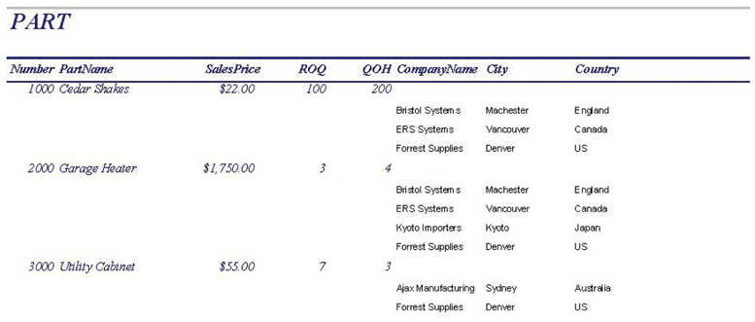
Strong Entity Patterns:
N:M Strong Entity Relationships
Dr. Ejaz Ahmed

Slide 12
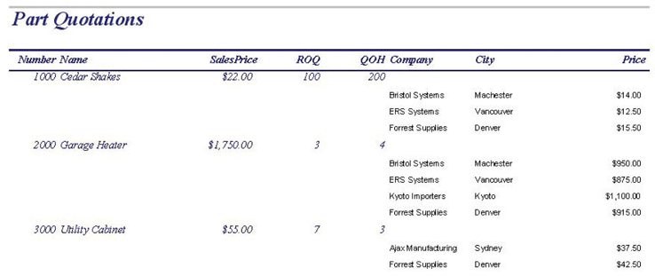
ID-Dependent Relationships:
The Association Pattern
Note the Price column, which has been added.
Dr. Ejaz Ahmed

Slide 13
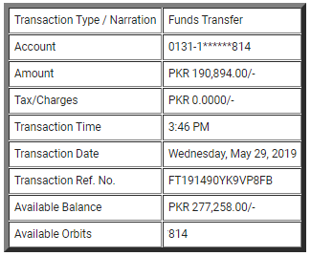
Exercise: Make a Form - UI
Dr. Ejaz Ahmed
Notes:
For this report, draw or mock up form for entering this transaction

Slide 14
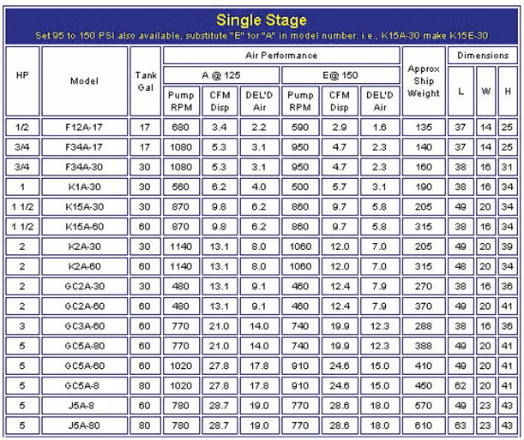
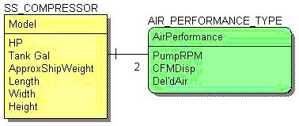
ER Model using Existing Data
Use ER-model symbols
5-<number>
Dr. Ejaz Ahmed

Slide 15
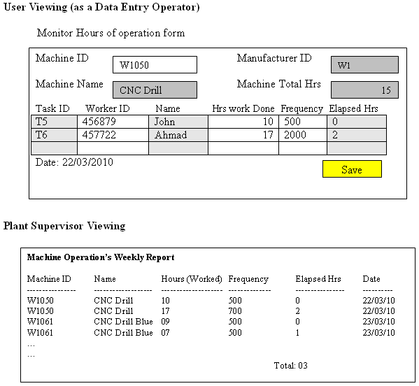
ER based on User’s Views – Machine Operation
Dr. Ejaz Ahmed

Slide 16
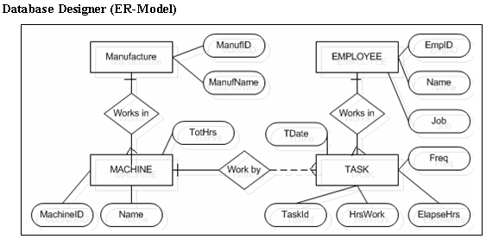
ER Mapping – Machine Operation ...
Dr. Ejaz Ahmed

Slide 17
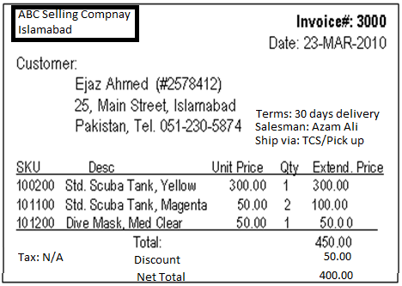
Exercise – ER Modeling & Mapping
Dr. Ejaz Ahmed

Slide 18
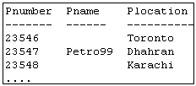
Mapping (Table Design) Regular Entity PROJECT
Name
Number
PROJECT
Location
ER Model
Relational Schema or ER Diagram
PROJECT
Pnumber
Pname
Plocation
PName must has NOT NULL constraint, Name is UNIQUE Key
Dr. Ejaz Ahmed

Slide 19
--- Mapping Regular Entity DEPARTMENT
Number
Name
NumberOfEmployees
DEPARTMENT
Location
ER Schema
Relational Schema
DEPARTMENT
Dname
Dnumber
Dr. Ejaz Ahmed
Notes:
Discuss the mapping of cases when there are fixed number of locations such as Loc1, Loc2.
When there are varied number of locations

Slide 20
… Mapping of 1:1 Relationship Types
…
Locations
Empno
Sex
StartDate
Name
DNumber
1
1
EMPLOYEE
MANAGES
DEPARTMENT
ER Model
Relational Schema
Dname
DNumber
MGRENO
MGRStartDate
Loc1
Loc2
DEPARTMENT
Foreign Key
MGRENO must be UNIQUE KEY to validate 1:1, Dname must has NOT NULL constraint
Dr. Ejaz Ahmed

Slide 21
… Mapping of 1:N Relationship Types
…
Locations
Empno
Sex
DName
DNum
N
1
EMPLOYEE
BELONGS_TO
DEPARTMENT
ER Model
Relational Schema or ER Diagram
EMPLOYEE
Fname
Minit
Lname
Emp#
Bdate
Sex
Address
Salary
DNum
DEPARTMENT
DNum
DName
Loc1
Loc2
Foreign Key
Dr. Ejaz Ahmed

Slide 22
… -- Alternate Mapping of 1:N Relationship Types
…
Locations
SSN
Sex
Name
Number
N
1
EMPLOYEE
BELONGS_TO
DEPARTMENT
(1,N)
(1,1)
ER Model
Relational Schema or ER Diagram
Fname
Minit
Lname
SSN
Bdate
Sex
Address
Salary
Dnum
EMPLOYEE
Foreign Key
Employee is mandatory, each department has one or more employees. Department must has at least one employee. For example, (1,1)-(0,N) means Employee is optional, some departments may be without any employee
Dr. Ejaz Ahmed

Slide 23
… Mapping of M:N Relationship Types
ESSN
…
Hours
…
PNO
N
M
EMPLOYEE
WORKS_ON
PROJECT
ER Model
Relational Schema or ER Diagram
WORKS_ON
ESSN
PNO
Hours
WORKS_ON
ESSN
PNO
Hours
WORK_ON table requires in addition to tables EMPLOYEE and PROJECT
ESSN and PNO are the composite keys, Hours must has NOT NULL constraint
Datasets is required
Dr. Ejaz Ahmed

Slide 24
… Mapping of N-ary Relationship Types
SNo
Sname
PART
PartNo
Pname
Quantity
PNo
L
SUPPLIER
SUPPLIES
PROJECT
M
N
ER Model
Relational Schema or ER Diagram
SUPPLY
SuppNo
PartNo
PNo
Quantity
Foreign Keys
Quantity must has NOT NULL constraint. Similar example can be Lecturer teaches course to students. Other example: Vehicle, Policeman, Ticket (Ticket# is a serial unique number)
Datasets is required
Dr. Ejaz Ahmed

Slide 25
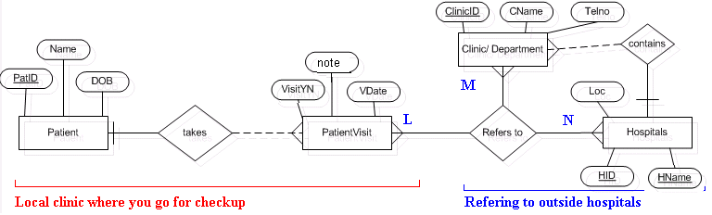
… Mapping of N-ary Relationship Types
ER Model
Relational Schema or ER Diagram
Exercise: Draw table or relational schema and User interface Form of this model
Datasets is required
Dr. Ejaz Ahmed

Slide 26
… Mapping of Recursive Relationship Types
CID
CName
…
SSN
Name
Sex
N
N
COURSE
Pre-requisite
EMPLOYEE
Supervisor
M
Manages
1
ER Model
Relational Schema or ER Diagram
Fname
Minit
Lname
SSN
Bdate
Sex
Address
Salary
MGRSSN
EMPLOYEE
Foreign Key
MGRSSN is a FK references to SSN in the same table Employee
Datasets is required
Dr. Ejaz Ahmed
Notes:
In terms of Person entity, Husband & Wife can be converted into Parents with recursive Relationship (1-1 or 1-4), because both entities have same columns
Research papers and their citations are recursive M-N

Slide 27
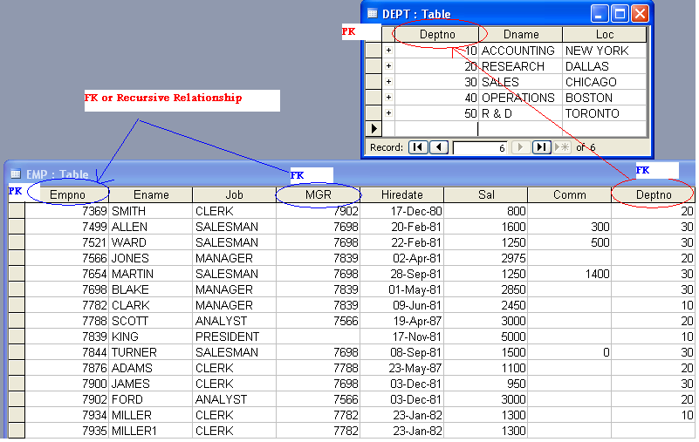
Example FK or Recursive Relationship
Dr. Ejaz Ahmed

Slide 28
… Mapping of Recursive Relationship Types
CID
CName
N
COURSE
Pre-requisite
M
ER Model
Relational Schema or ER Diagram
Dr. Ejaz Ahmed

Slide 29
Cardinality
1
N
PROFESSOR
teaches
CLASS
(1,1)
(0,3)
A university limits the professor to teaching a max. of 3 classes per semester.
M
N
STUDENT
CLASS
enrolled
(0,35)
(1,6)
A university may decide to limit a student to a max. of 6 classes per semester, and class size may be limited to 35 students or no student.
(0,35) for class: class may contain no students or up to 35 students
(1,6) for student : student must take at least one class or up to 6 classes
Dr. Ejaz Ahmed

Slide 30
-- Mapping of Weak Entity Types …
For each weak entity type W in the ER schema with owner entity type E, create a relation R that includes all the simple attributes of W (or simple components of composite attributes) as attributes of R.
In addition, include as foreign key attributes of R the primary key attribute(s) of the relation(s) that correspond to the owner entity type(s); this takes care of the identifying relationship type of W. The primary key of R is the combination of the primary key(s) of the owner(s) and the partial key of the weak entity type W, if any.
Dr. Ejaz Ahmed

Slide 31
… -- Mapping of Weak Entity Types
In the COMPANY database example, we created the relation DEPENDENT, in this step to correspond to the weak entity type DEPENDENT. We include the primary key SSN of the EMPLOYEE relation – which correspond to the owner entity type as a foreign key attribute of DEPENDENT; we renamed it ESSN; although this is not necessary. The primary key of dependent relation is the combination {ESSN, DEPENDENT_NAME} because DEPENDENT_NAME is the partial key of the weak entity DEPENDENT.
Dr. Ejaz Ahmed

Slide 32
--- Mapping Weak Entity DEPENDENT
…
BirthDate
SSN
Sex
Name
Relationship
1
M
EMPLOYEE
Dependents_of
DEPENDENT
Sex
ER Schema
Relational Schema
DEPENDENT
ESSN
SNO
DependentName
Sex
Bdate
Relationship
In the book Dependent name is shown a part of composite Key for Dependent – which is not valid choice
Dr. Ejaz Ahmed

Slide 33
Datasets – Weak Entity Relationships
Exercise
Loan & its Installments details, draw its ER and Mapping, Produce datasets with all possible records
Dr. Ejaz Ahmed

Slide 34
- Mapping Relationship Types
Mapping of 1:1 Relationship Types +
Mapping of 1:N Relationship Types +
Mapping of M:N Relationship Types +
Mapping of N-ary Relationship Types +
Dr. Ejaz Ahmed

Slide 35
-- Mapping of 1:1 Relationship Types …
For each binary 1:1 relationship type R in the ER schema, identify the relations S and T that correspond to the entity types participating in R. Choose one of the relations, say S, and include as the foreign key in S the primary key of T. It is better to choose S as the entity type with total participation in R.
Dr. Ejaz Ahmed

Slide 36
… -- Mapping of 1:1 Relationship Types …
In the COMPANY database example we map the 1:1 relationship type MANAGES, by choosing the participating entity type DEPARTMENT to serve in the role of S, because its participation in the MANAGES relationship type is total (Every department has a manager).
We include the primary key of EMPLOYEE relation as a foreign key in the DEPARTMENT relation and we name it MRGSSN.
We also include the simple attribute StartDate of the MANAGES relationship type in the DEPARTMENT relation and rename it as MGRSTARTDATE.
Dr. Ejaz Ahmed

Slide 37
-- Mapping of 1:N Relationship Types …
For each regular binary 1:N relationship type R in the ER schema,
  identify the relations S that represent the participating entity type at the N-side of R.
  Include as foreign key in S the primary key of the relation T that represents the other entity type participating in R; this is because each entity instance on the N-side is related to at most one entity instance one the 1-side of the relationship type.
  Include any simple attributes (or simple components of composite attributes) of the 1:N relationship type as attributes of S.
Dr. Ejaz Ahmed

Slide 38
… -- Mapping of 1:N Relationship Types …
In the COMPANY database example, we now map the 1:N relationship types WORKS_FOR, CONTROLS, and SUPERVISION.
  For WORKS_FOR we include the primary key DNUMBER of the DEPARTMENT relation as a foreign key in the EMPLOYEE relation and call it DNO.
  For CONTROLS we include the primary key DNUMBER of the DEPARTMENT relation as a foreign key in the project relation and call it DNUM.
  For SUPERVISION we include the primary key SSN of the EMPLOYEE relation as a foreign key in the EMPLOYEE relation itself and call it SUPERSSN.
Dr. Ejaz Ahmed

Slide 39
-- Mapping of M:N Relationship Types …
For each binary M:N relationship type R in the ER schema
  Create a new relation S to represent R.
  Include as foreign key attributes in S the primary keys of the relations that represent the participating entity types R.
  The combination of these keys will represent the primary key for S.
  Also include any simple attributes of R (or simple components of composite attributes) as attribute of S.
Dr. Ejaz Ahmed

Slide 40
… -- Mapping of M:N Relationship Types
In the COMPANY database example
  we map M:N relationship type WORKS_ON by creating a new relation WORKS_ON.
  We include the primary keys of the PROJECT and EMPLOYEE relations as foreign keys in WORKS_ON and rename them PNO and ESSN, respectively.
  We also include the attribute HOURS in WORKS_ON to represent Hours attribute of the relationship type.
  The primary key of the WORKS_ON relation is the combination {ESSN, DNO}
Dr. Ejaz Ahmed

Slide 41
-- Mapping of N-ary Relationship Types …
For each n-ary relationship type R in the ER schema, where n > 2:
  create a new relation S to represent R.
  Include as foreign key attributes in S the primary keys of the relations that represent the participating entity types in R.
  The combination of these keys will represent the primary key of S.
  Also, include any simple attributes of R (or simple components of composite attributes) as attributes of S.
Dr. Ejaz Ahmed

Slide 42
… -- Mapping of N-ary Relationship Types
  For example, the relationship type SUPPLY (shown in the following figure) can be mapped to the relation SUPPLY whose primary key is the combination of foreign keys {SNAME, PARTNO, PROJNAME}
Dr. Ejaz Ahmed

Slide 43
- Mapping Multi-valued Attributes …
For each multi-valued attribute Am create anew relation R.
This relation R will include an attribute corresponding to A plus the primary key attribute K – as a foreign key in R – of the relation that represents the entity type or relationship type that has A as an attribute.
The primary key of R is the combination of A and K.
If the multi-valued attribute is composite, we include its simple components.
Dr. Ejaz Ahmed

Slide 44
… - Mapping Multi-valued Attributes …
In the COMPANY database example:
  We create a relation DEPT_LOCATIONS.
  The attribute DLOCATION represents the multi-valued attribute Locations of DEPARTMENT.
  DNUMBER – as foreign key – represents the primary key of the DEPARTMENT relation.
  The primary key of DEPT_LOCATION is the combination {DNUMBER, DLOCATION}.
  A separate tuple will exist in DEPT_LOCATIONS for each location that a department has.
Dr. Ejaz Ahmed

Slide 45
…-- Mapping Exercise (DB Implementation):
Students are enrolled in courses in more than one semester. Each course may have one or more sections like 01, 02, 03 etc. Each student can take grades like A+, A, B+, B ….. F etc. in enrolled courses. Student can re-enrolled if grade F is taken in a course.
Draw ER Diagram/ ER-Model
Produce mapping of ER-Model
Identify clearly PK/ Composite Keys, FKs and Simple/ single Attributes
Write a create table script with above constraints
Dr. Ejaz Ahmed

Slide 46
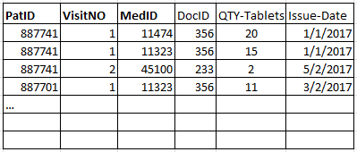
Exercise
To enhance above details of issuing medicines to patients. Database schema can store information such as
patients' and doctors' personal details; visit details such as visit date, diagnosis of visit, visit status.
Medicine names, price and total quantity of each medicines. Draw ER diagram, its mapping and database state
of enhanced details.
Dr. Ejaz Ahmed
Notes:
Ref. Slide Doctor-Drug-Patient

Slide 47
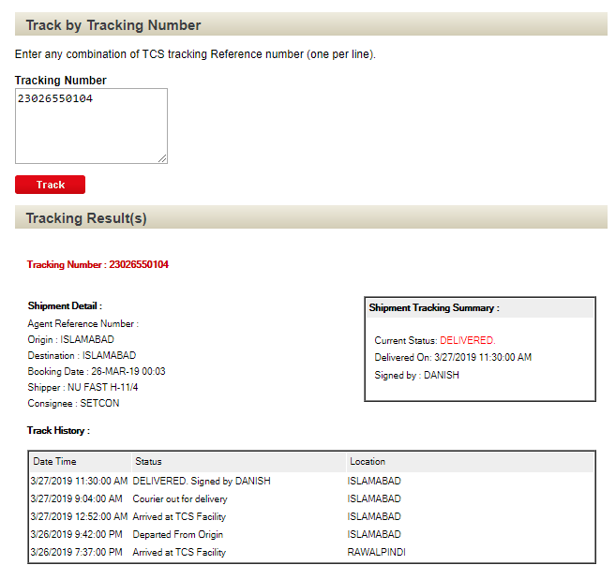
Enterprise: TCS System
Dr. Ejaz Ahmed

Slide 48
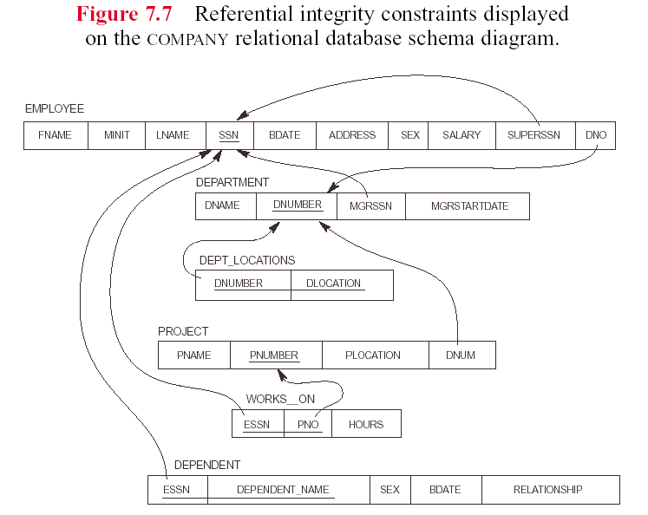
Dr. Ejaz Ahmed

Slide 49
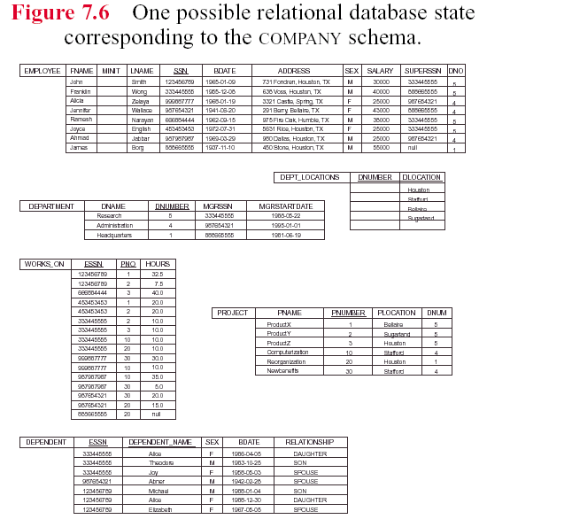
Dr. Ejaz Ahmed

Slide 50
Summary – DB Implementation
Create PK/ CK (must), FK (if any), Cardinalities
At least one non-key column NOT NULL in table
Other constraints
  Check/ Range, UNIQUE, NOT NULL, Default (if any)
  Constraints using triggers
Validate Normalization BCNF/ 3NF
Assign appropriate data types and size
Dr. Ejaz Ahmed

Slide 51
End
Dr. Ejaz Ahmed

